Slide 1


SUNFLOWER COUNTY CONSOLIDATED SCHOOL DISTRICT
ESSER 2&3 Phase I: all schools’ ESSER except for High Schools
ESSER 2&3 Phase II: High School ESSER projects
Bond Issue: New High School Renovations & Secure Entry work for all schools
ESSER & Bond Project Review

Slide 2
ESSER 2&3 Phase I
  AW James Elementary School
  Carver Elementary School
  Drew Hunter Middle School
  Lockard Elementary School
  Robert L Merritt Middle School
  Ruleville Elementary School
  Ruleville Middle School
Reevaluating Scope

Slide 3
ESSER 2&3 Phase II
  Thomas Edwards High School
  Gentry High School

Slide 4
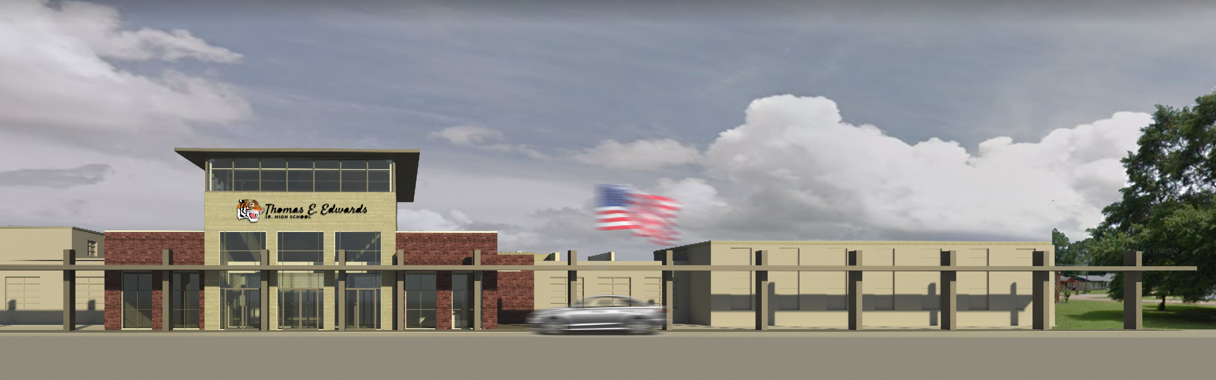
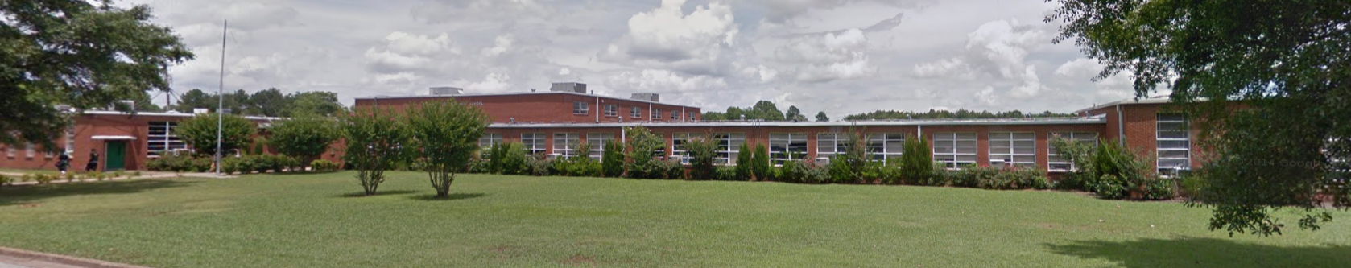
Thomas Edwards High School
New Entry

Slide 5
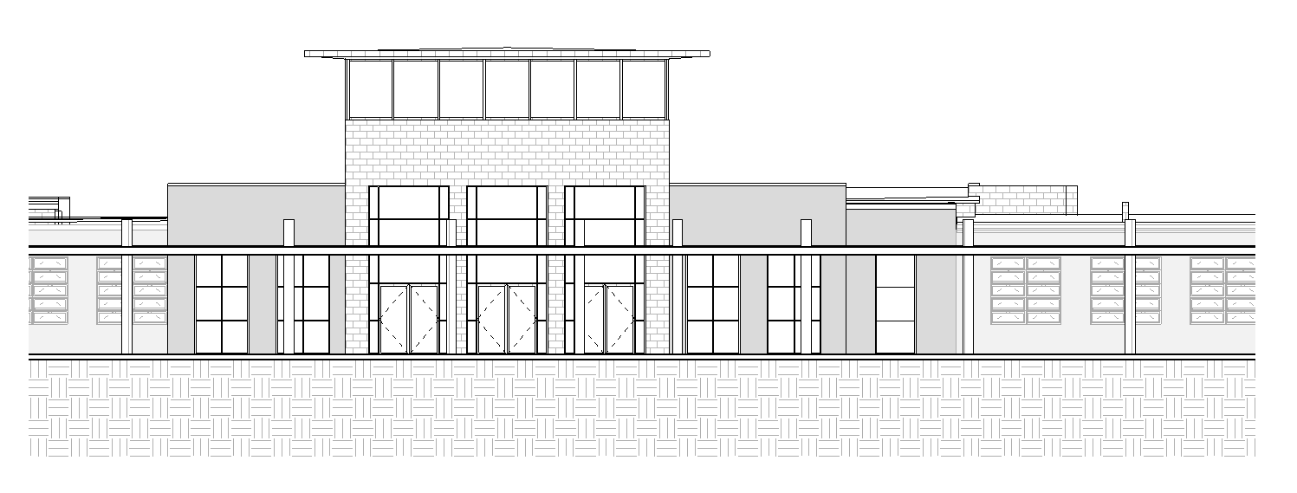
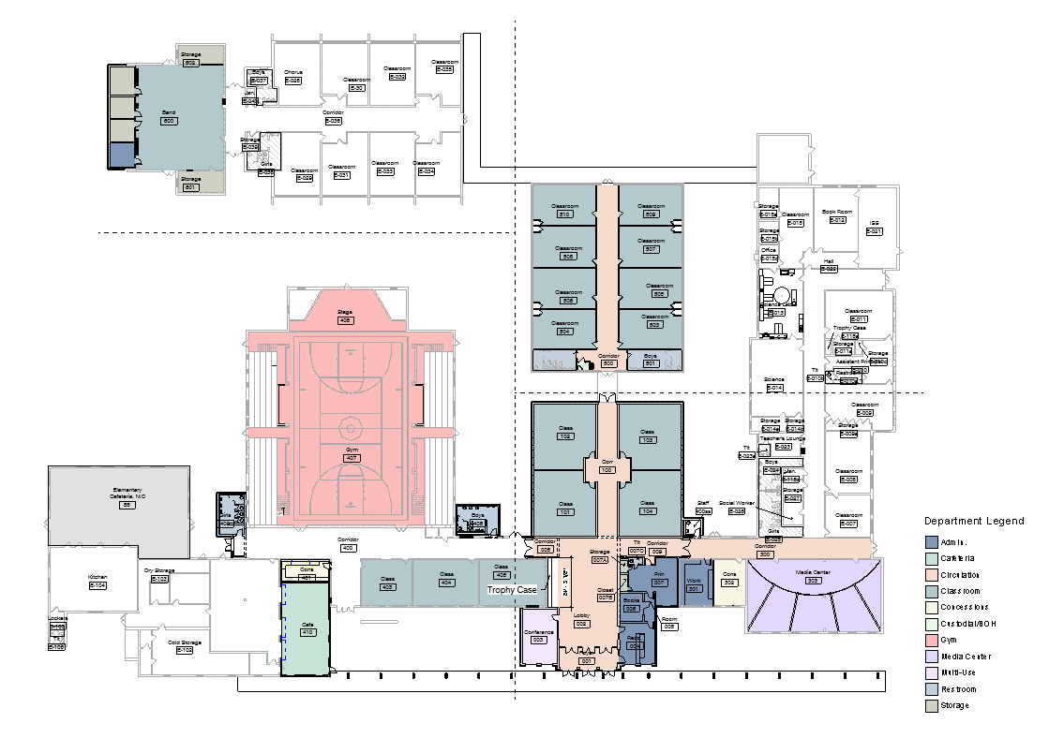
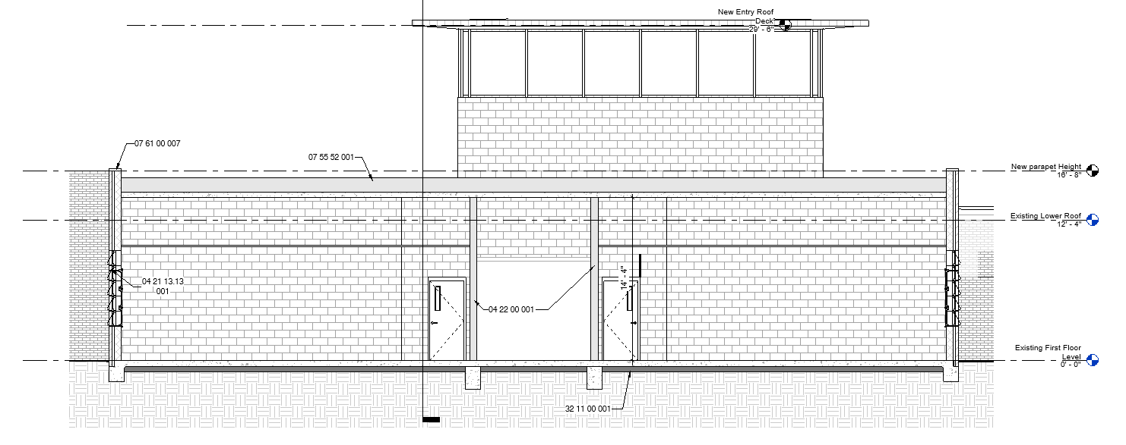
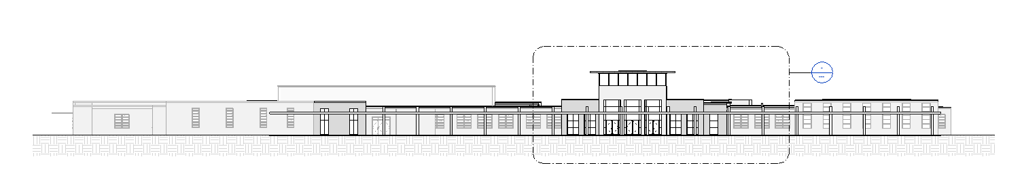
Thomas Edwards High School
New Floor Plan

Slide 6
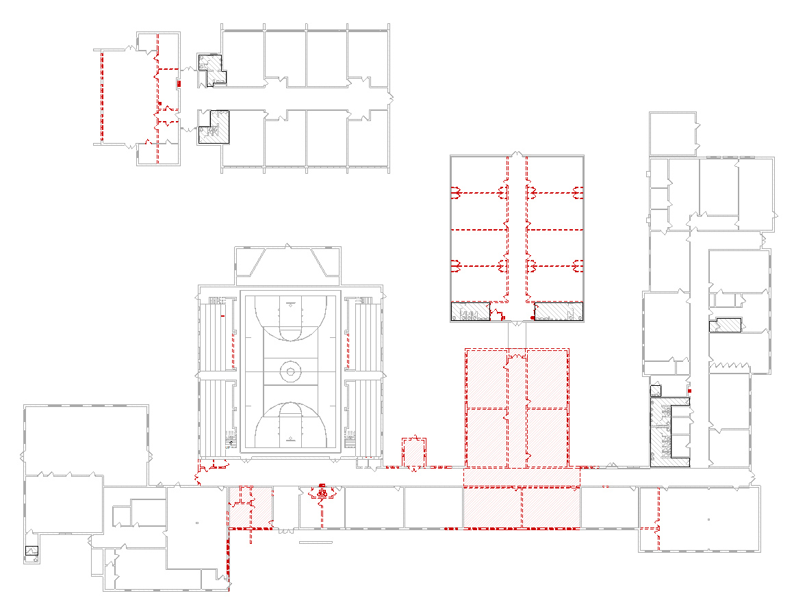
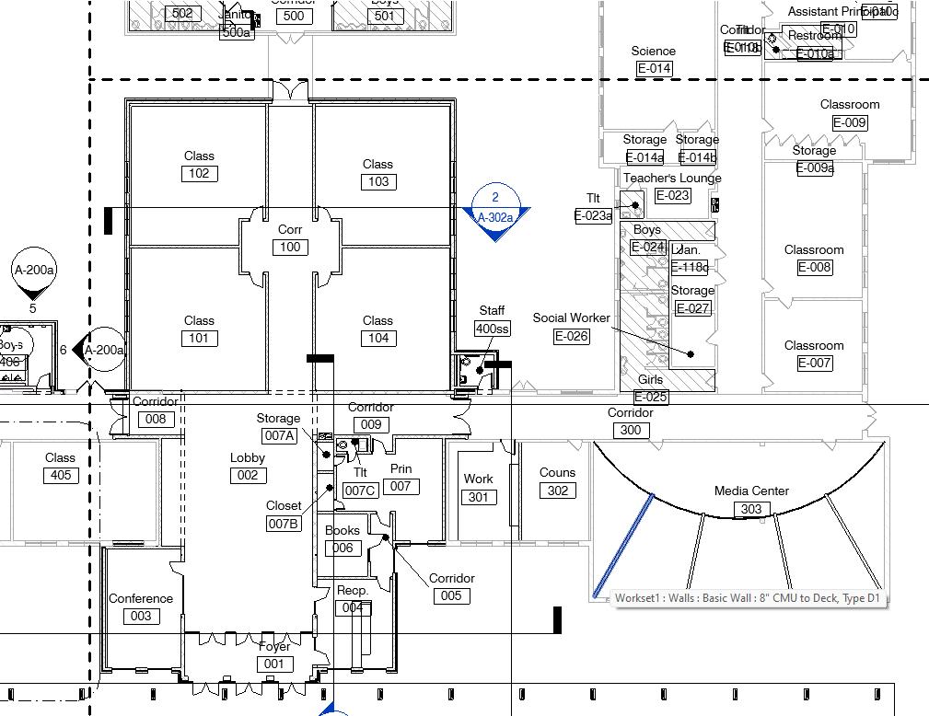
Thomas Edwards High School
New Demolition Plan
New Entry

Slide 7
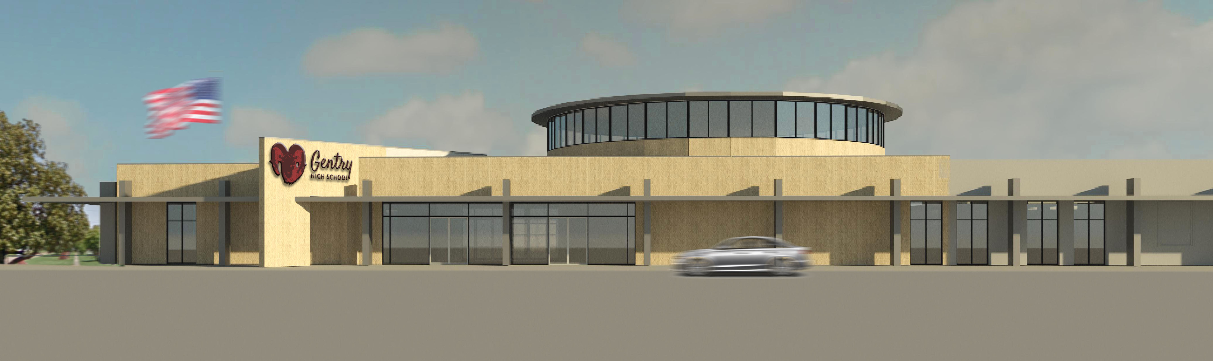
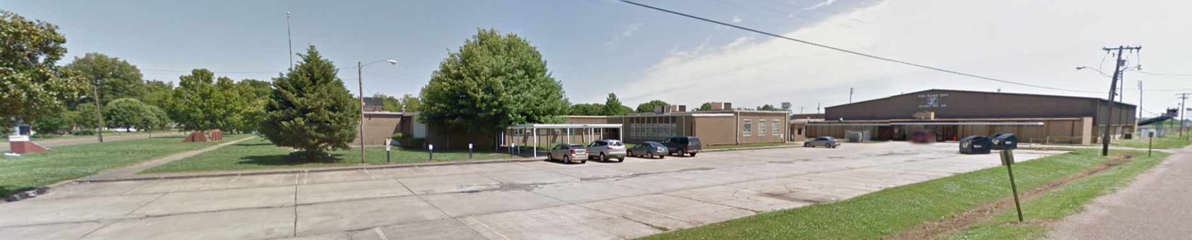
Gentry High School
New Entry

Slide 8
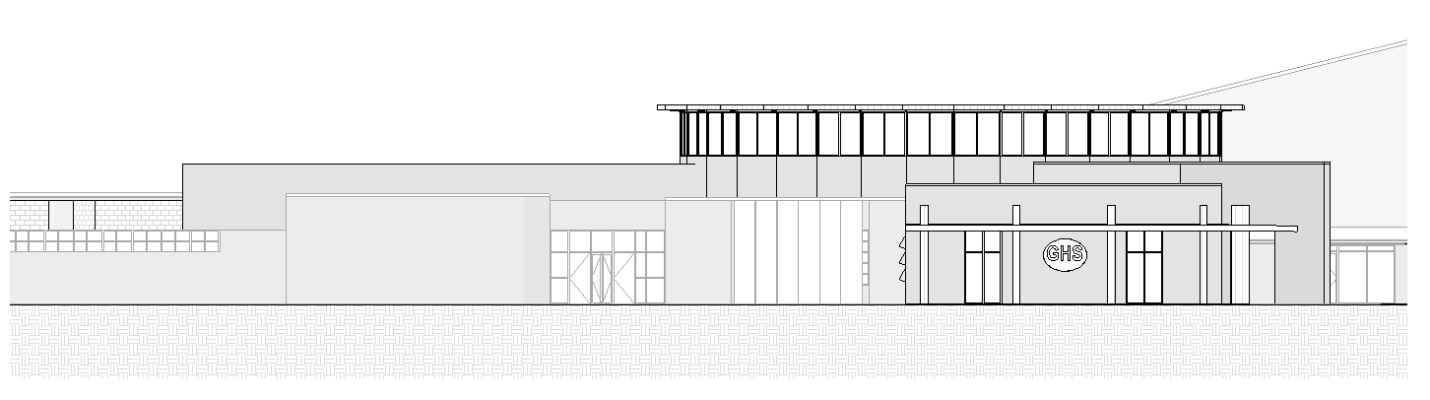
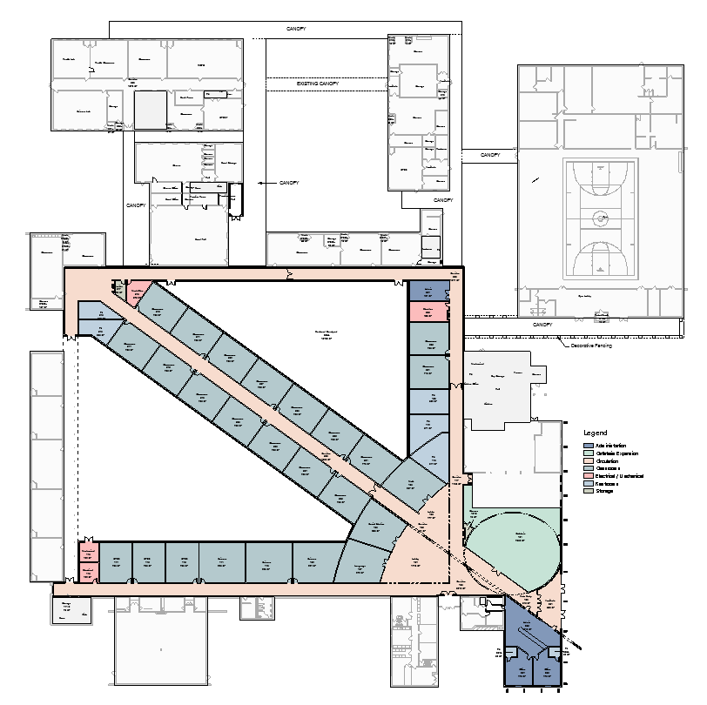
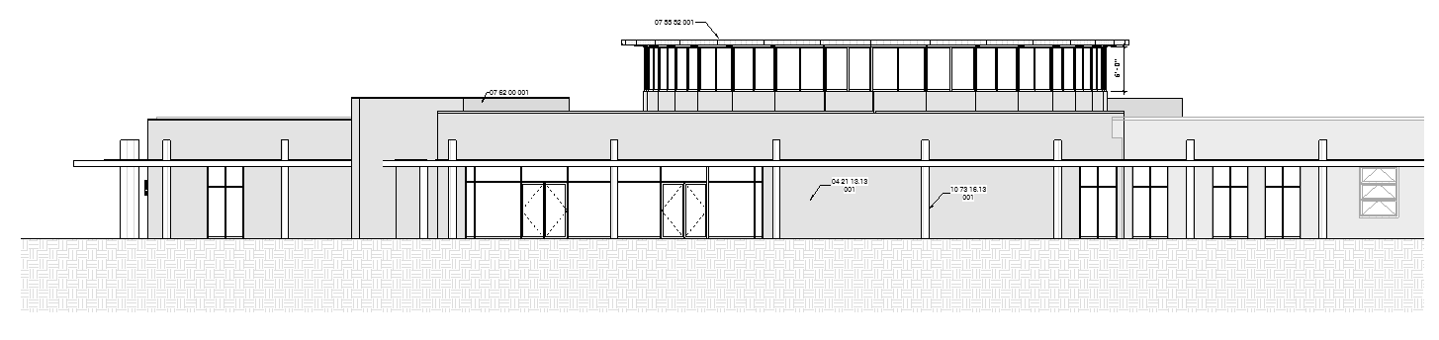
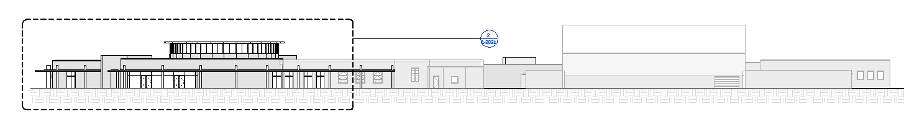
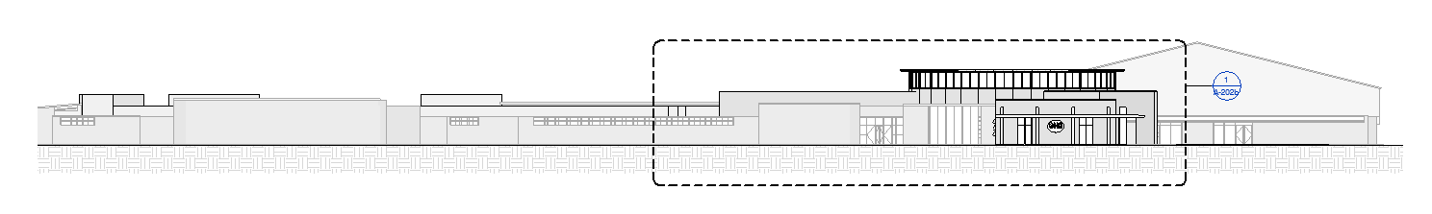
Gentry High School
New Floor Plan

Slide 9
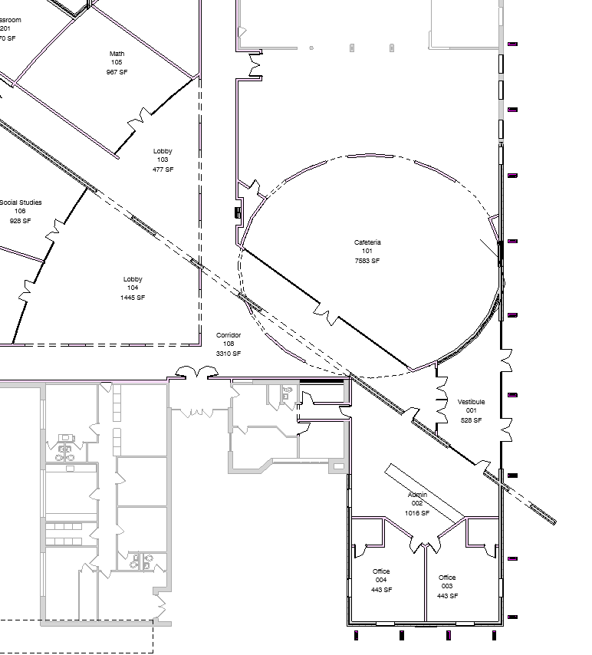
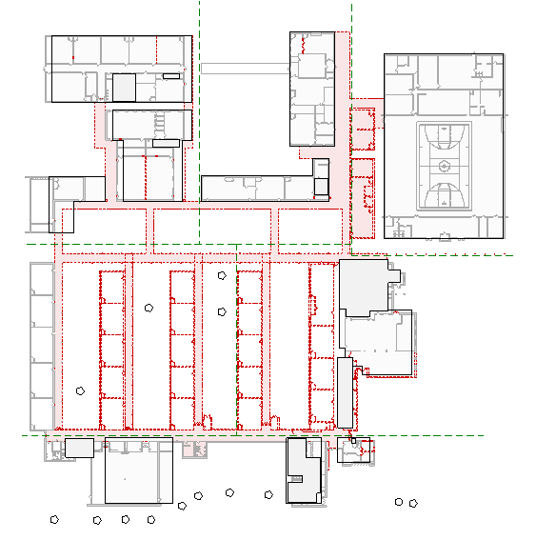
Gentry High School
New Demolition Plan
New Entry

Slide 10
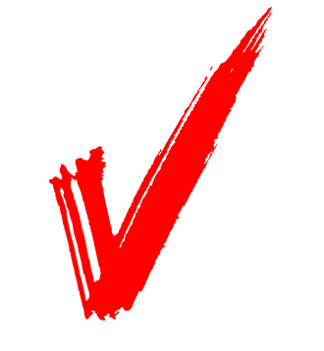
Schedules
    Milestones
    Schematic Design: 12/14/2021
    Construction Documents @ 90%: 1/27/2022
    Construction Documents in Full: 2/9/2022
    Bidding: 3/9/2021
    Reevaluation of Scope
    Schematic Design: 12/14/2021
    Design Development: 2/18/2022
    Construction Documents @ 90%: 4/25/2022
    Construction Documents in Full: 5/2/2022
    Bidding: 6/2/2021
    Construction Estimated Completion: Fall of 2024
  ESSER 2&3 Phase I
  ESSER 2&3 Phase II + Bond

