Slide 1
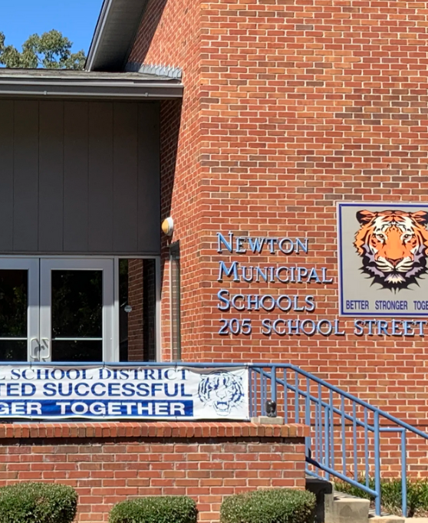

Newton Municipal School District Bond
New Looks for
Elementary & HS Gym

Slide 2
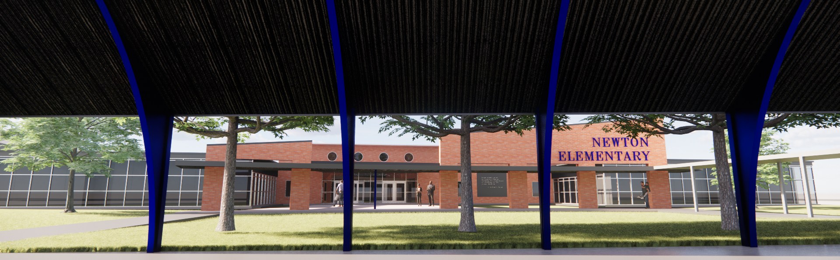
Newton Elementary School

Slide 3
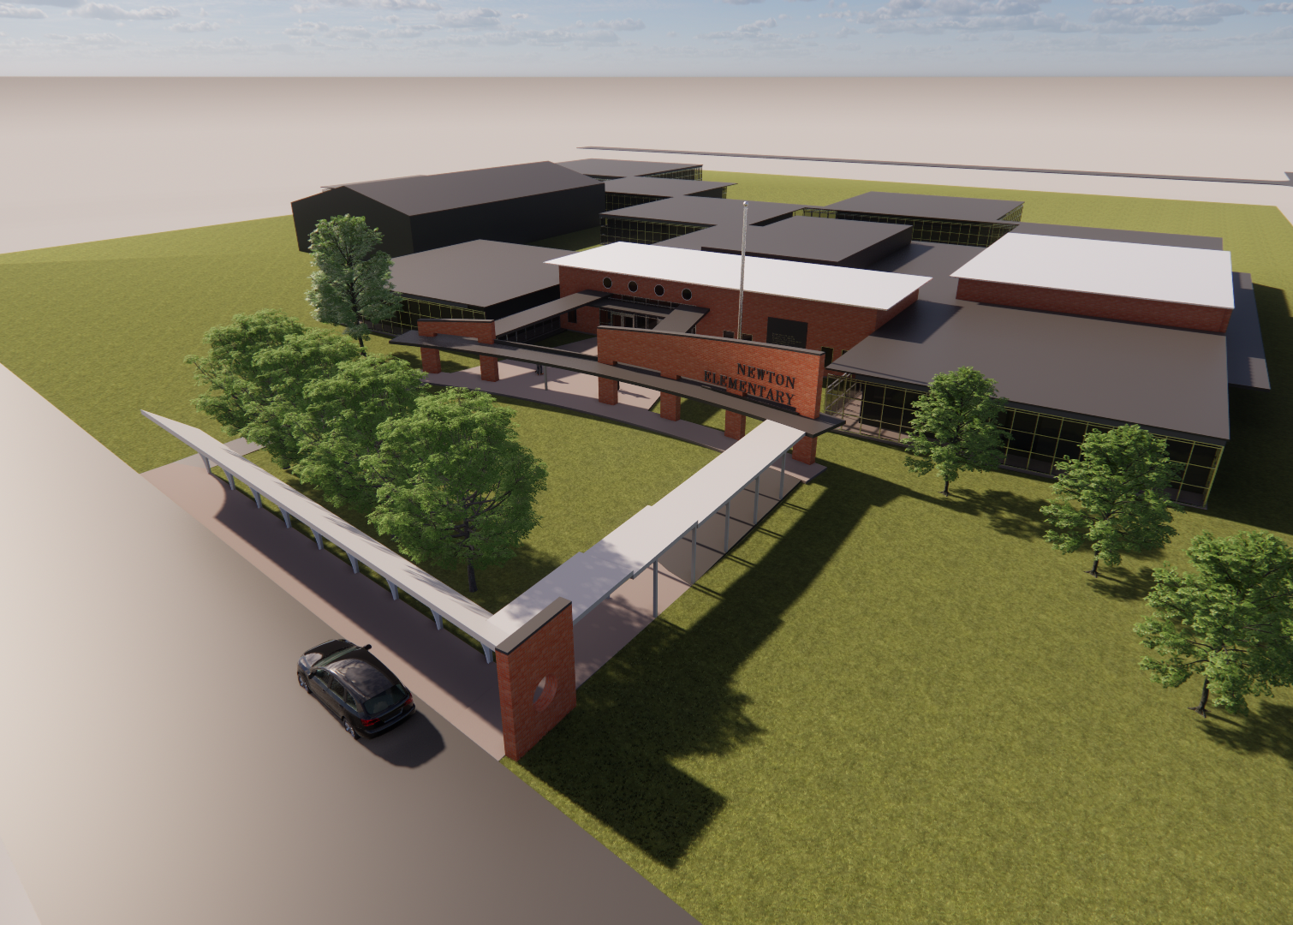
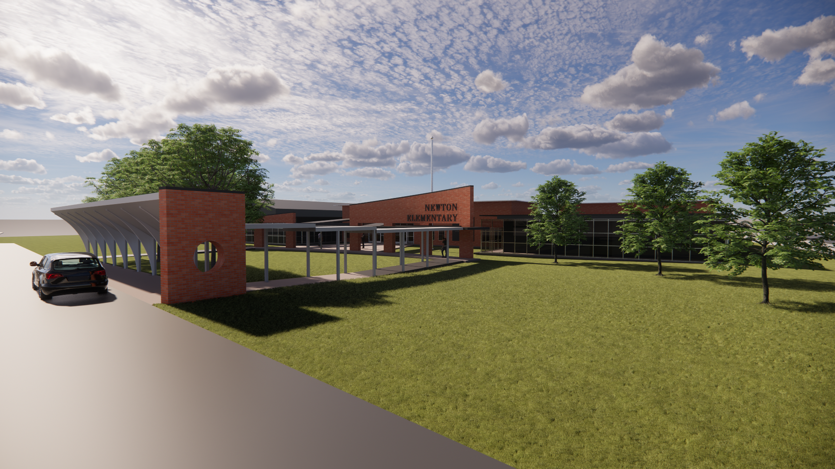
Bird’s Eye
Entry with Covered Awning

Slide 4
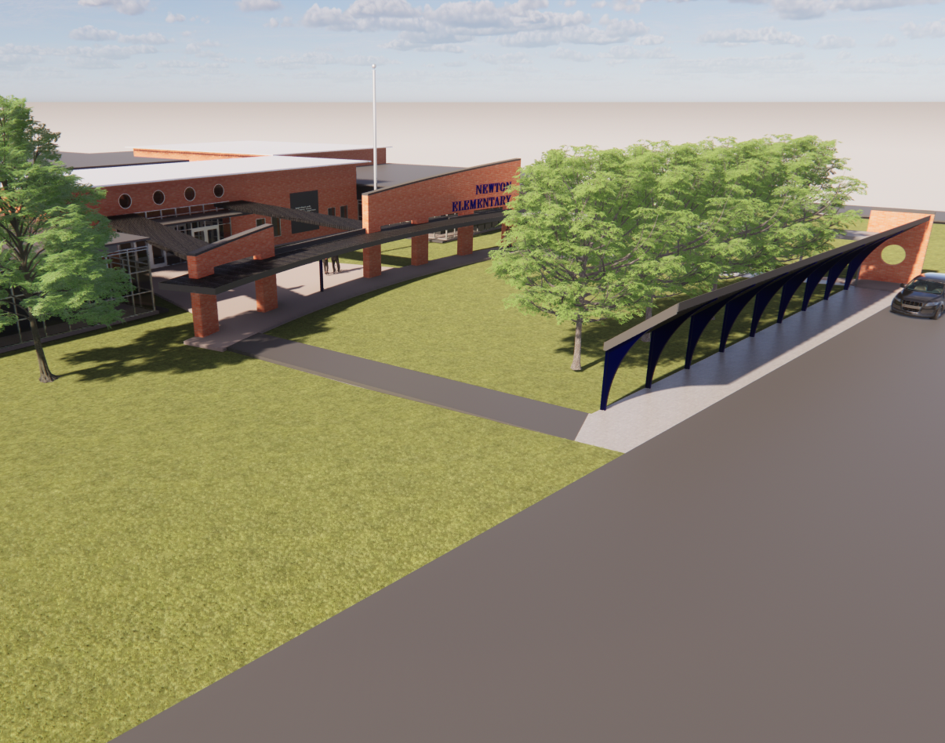
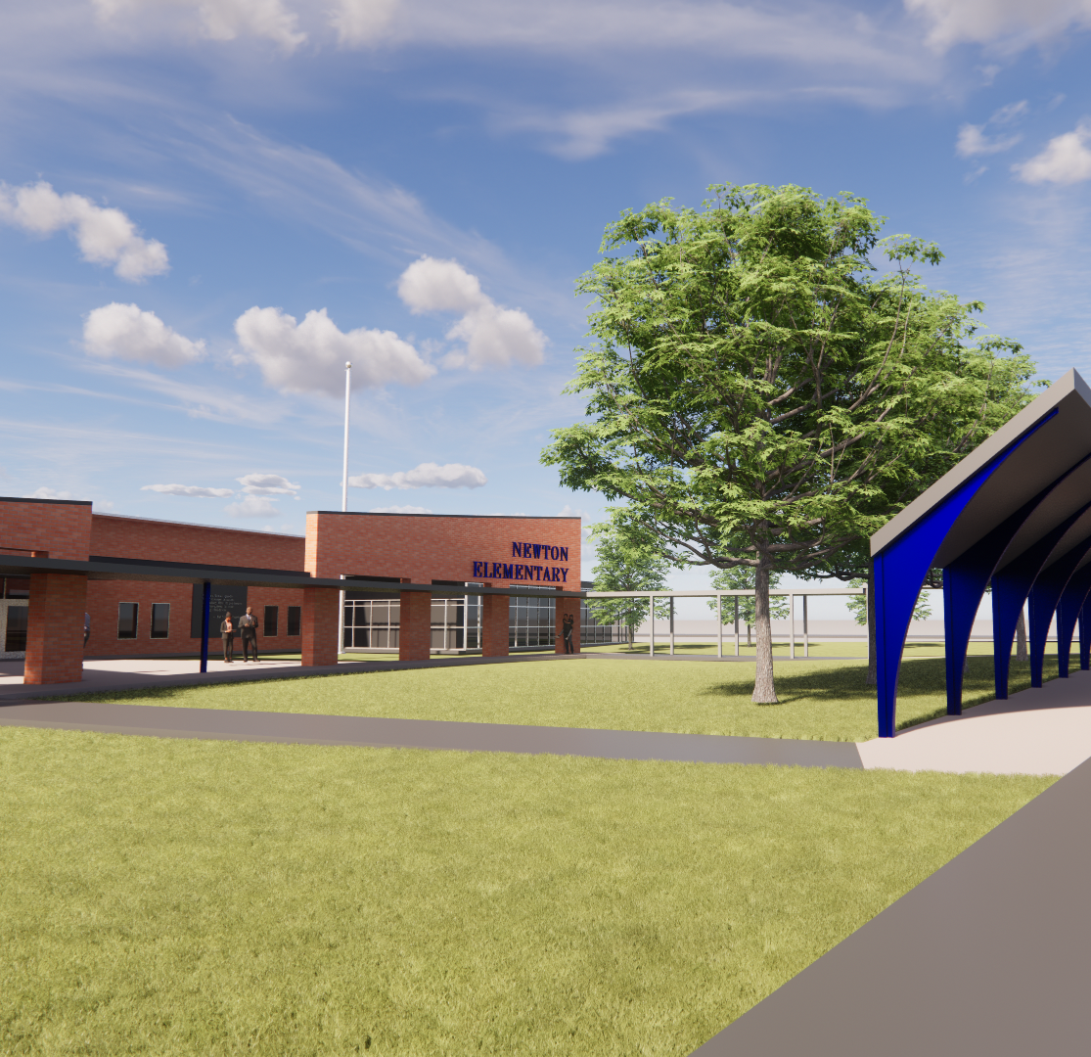
Newton Elementary
New Administration
New Covered Awning & Entry
New Connector Hall for All Buildings
Renovations to Existing Building
Expanded Cafeteria

Slide 5
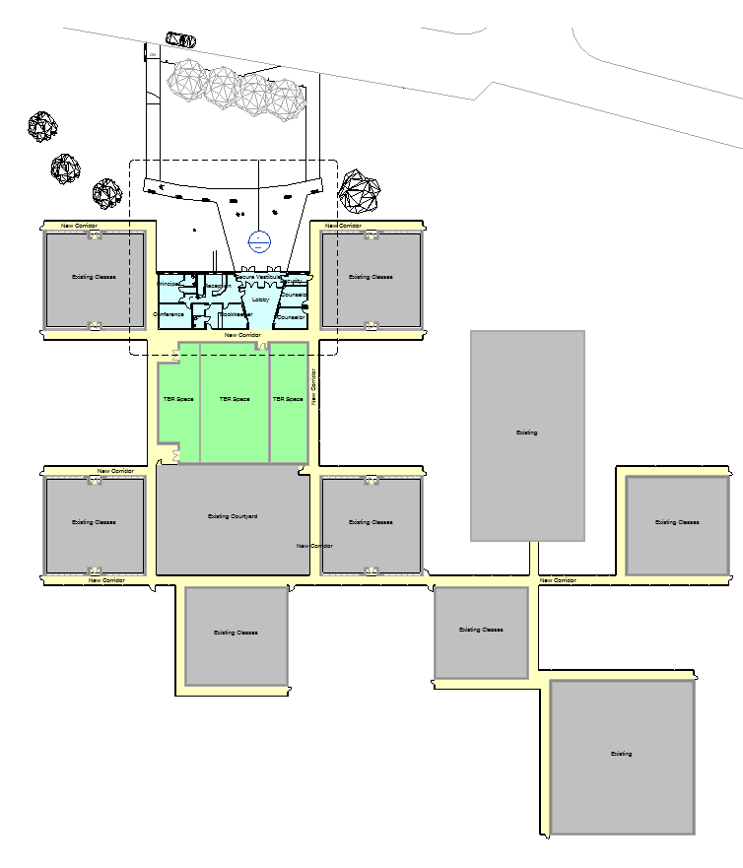
Floor Plans
Yellow – New Connector Hall
  11,200 SQFT
Green – To be renovated
  5,800 SQFT
Blue – New Construction
  2,800 SQFT

Slide 6
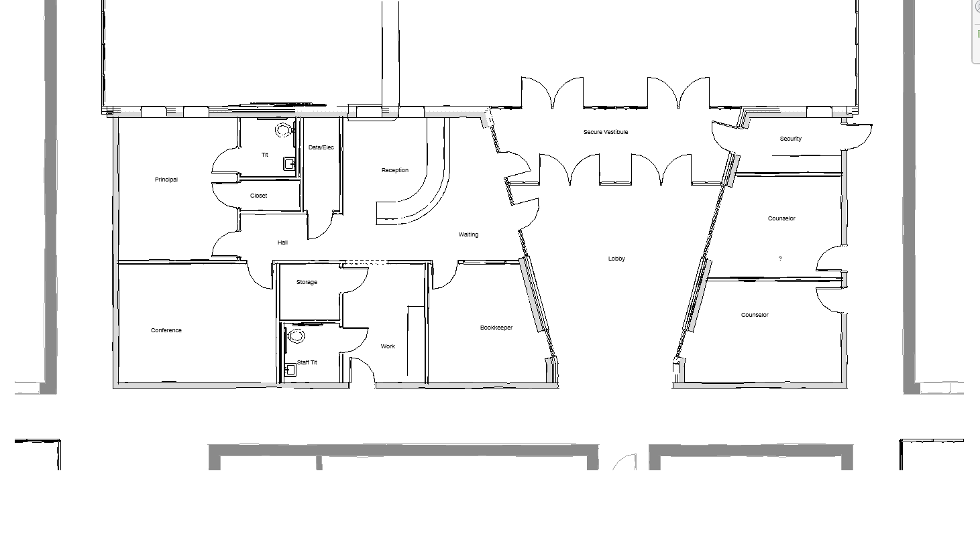
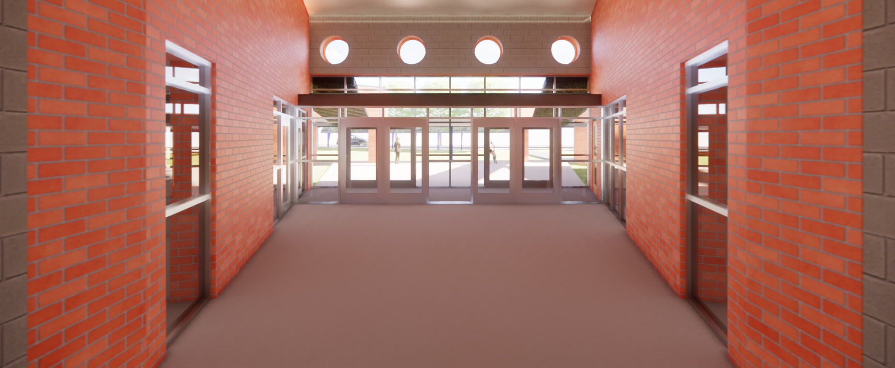
Floor Plans
Secure Vestibule
Lobby
SRO Office
Counselor Offices x2
Reception & Waiting
Bookkeeper Office
Principal Office
Work Room & Staff Toilet
Conference Room

Slide 7
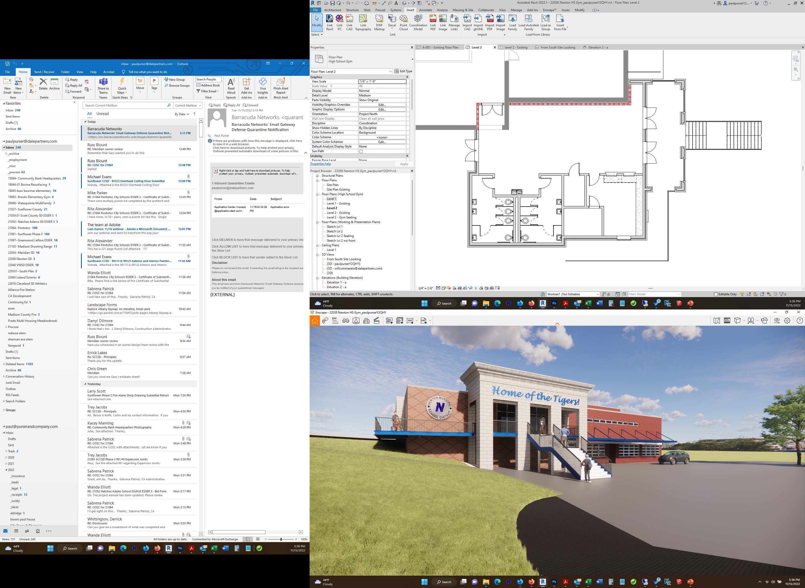
Newton High School Gym

Slide 8
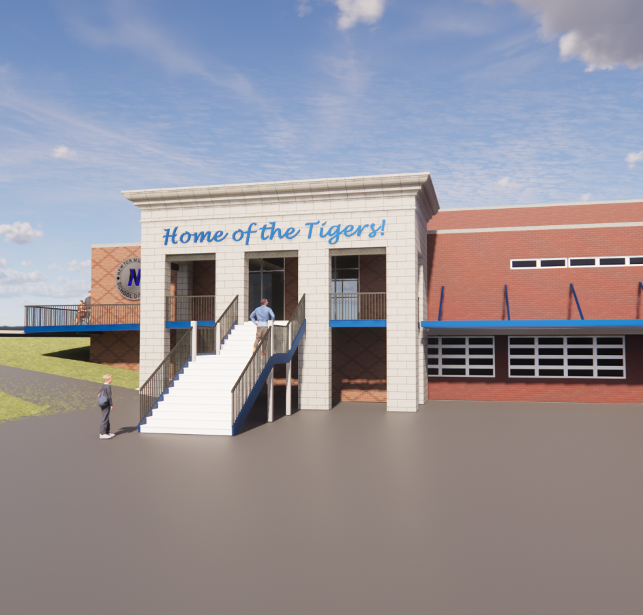
Newton HS Gym
New Entry/Lobby
New Concessions & Toilets
Renovations to Existing Lockers
New Mechanical Systems
New Roof & Refinish Flooring

Slide 9
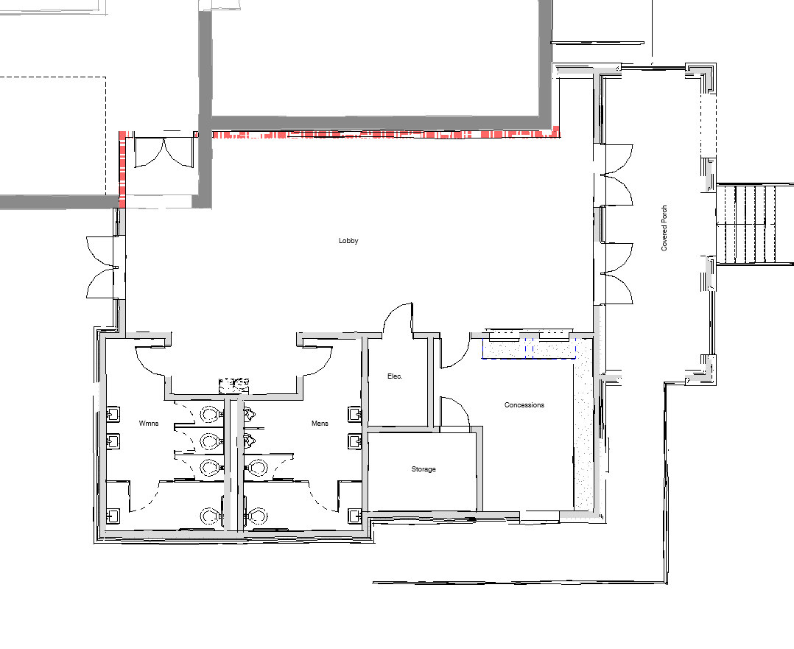
Floor Plans
Grand Lobby Space
Men’s & Women’s Toilets
Concessions
Covered Porch
ADA Access available to Covered Porch from Upper Parking Lot

Slide 10



Newton Municipal SD Bond Issue
NMSD
Dale | Bailey
Newton Elementary
Newton High School

